Slide 1


Unlocking Campaign Success: A Data-Driven Approach
This presentation analyzes recent ad campaign performance, highlighting key metrics and strategic optimizations for future success. We'll explore how data drives informed decisions.
by Smit More

Slide 2

Campaign Performance Overview: Key Metrics
1.5M+
120K+
3.5%
15%
Impressions
Engagements
CTR
ROI
Total reach across platforms
Likes, comments, shares
Click-through rate achieved
Return on investment

Slide 3


Platform Breakdown: Facebook vs. Instagram
Facebook Insights
Instagram Strengths
Higher impression volume
Superior visual engagement
Stronger engagement on long-form content
Higher click-through rates for product-focused ads
Cost-effective for broad reach
Ideal for younger demographics

Slide 4

Engagement Deep Dive: Beyond the Click
Content Relevance
Tailoring creative to audience segments
Interactive Elements
Polls, quizzes, and direct questions drove interaction
Community Building
Responsive commenting increased brand loyalty

Slide 5
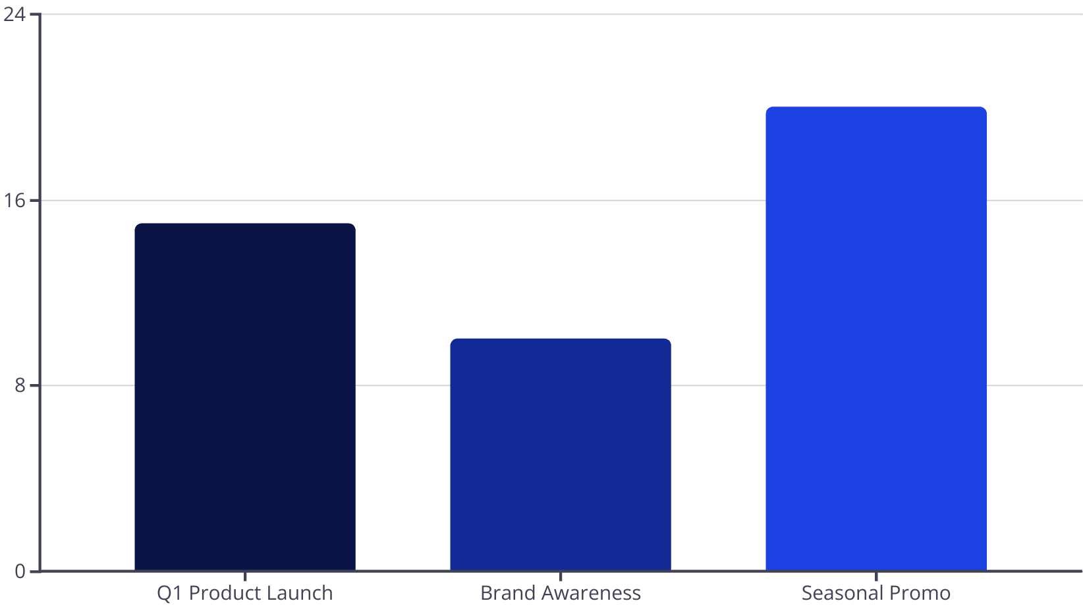

Understanding Your Return on Investment (ROI)
ROI analysis reveals the financial impact of each campaign. Strategic allocation maximizes budget efficiency.

Slide 6





Tools for Success: Our Analytics Stack
Power BI
Robust data visualization and reporting
Google Looker Studio
Customizable dashboards and real-time insights
Excel/Sheets
Detailed data manipulation and analysis
Canva (Optional)
Enhancing visual storytelling for reports

Slide 7




Next Steps: Optimizing for Future Campaigns
A/B Testing
Continual experimentation for ad creatives
Audience Refinement
Deeper segmentation for targeting
Budget Reallocation
Investing in top-performing channels

Slide 8

Key Takeaways & Call to Action
Data is Power
Ready to Grow?
Insights drive performance
Let's schedule a follow-up to discuss tailored strategies for your next campaigns.
Continuous optimization is key
Strategic tool utilization

